Slide 1

Marketing Strategy
Using B2C Marketing to Rise in the B2B Sector

Slide 2
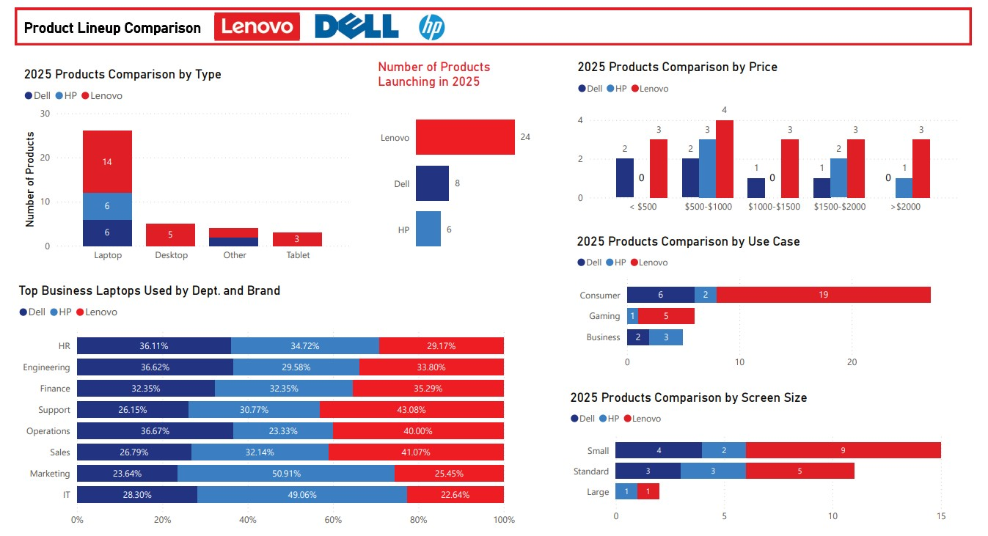

Slide 3
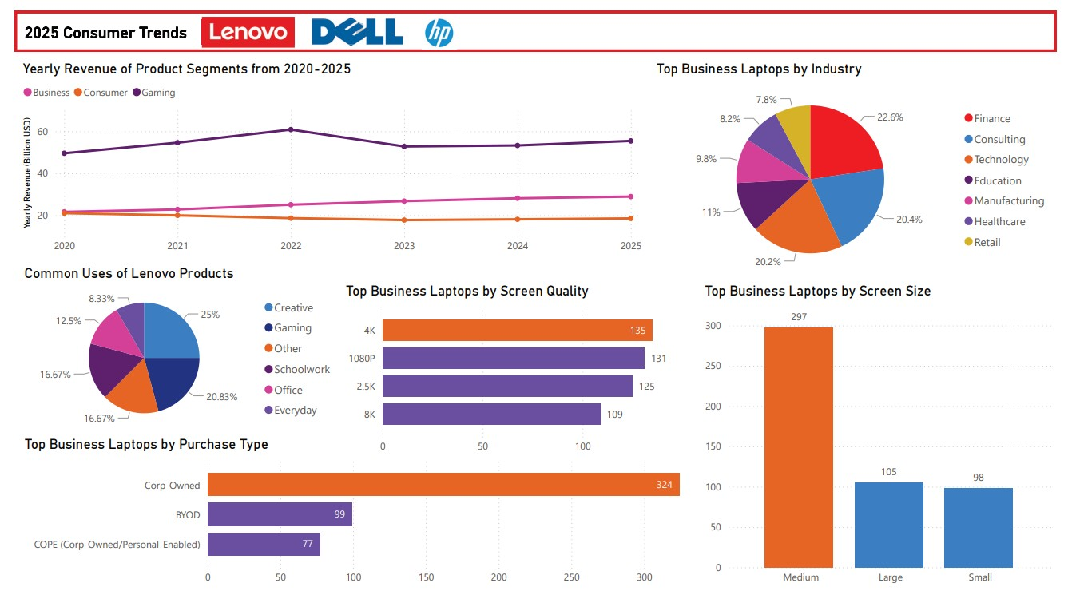

Slide 4
Lenovo is LAcking in the Business Sector
Out of their 2025 products, Lenovo dominates the consumer and gaming sectors, while Dell and HP produce more business focused laptops.
Dell and HP laptops are also used in more technologically heavy departments like Engineering, Finance, and IT.
Notes:
Only 12.5% of Lenovo users do office work compared to gaming and creative uses.

Slide 5
The Business Segment
Compared to the gaming and consumer sectors, the business sector has seen linear growth in Y-O-Y revenue from 2020-2025.

Slide 6
So where should lenovo target?
Out of the top business laptops used by employees today, most are used in finance, consulting, and technology companies.
Most laptops are corp-owned, so Lenovo should focus on B2B marketing.

Slide 7
B2C Strategies
For
B2b Marketing
To increase B2B sales and overpower competition in the finance, consulting, and technology industries, Lenovo needs to use social media and influencer marketing.

Slide 8
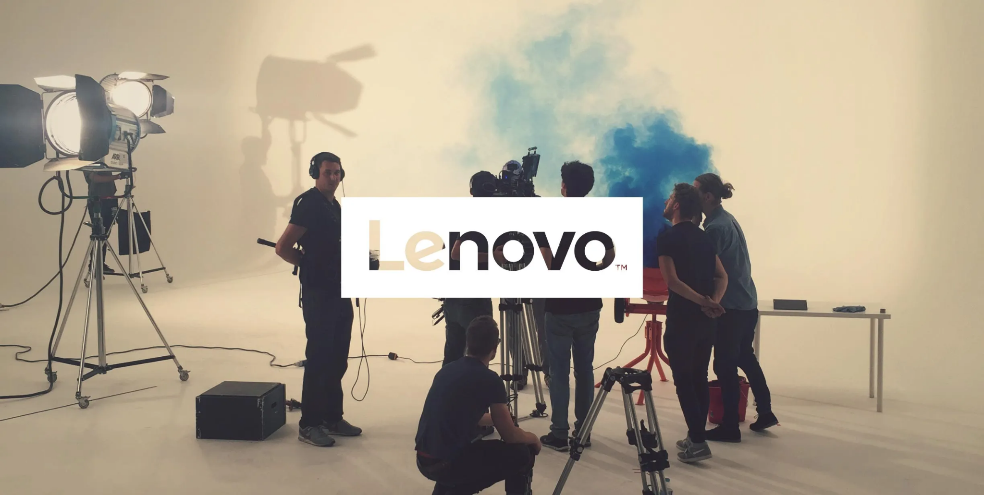
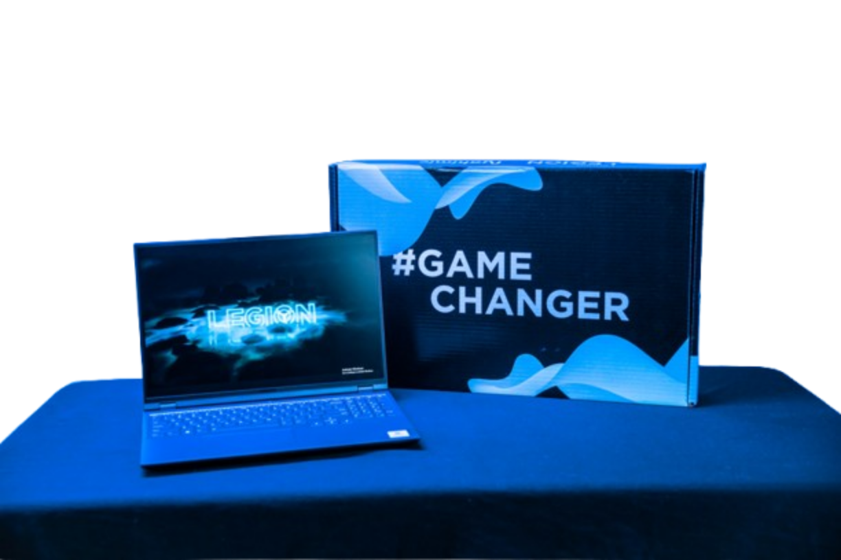
Lenovo’s Previous Programs
Lenovo already has influencer programs, like the Legion affiliate program and the “#GoodWeird” campaign promoting the YOGA line.
However, none of these attract our target audience of businesses.
Target top executives at prospective companies

Slide 9
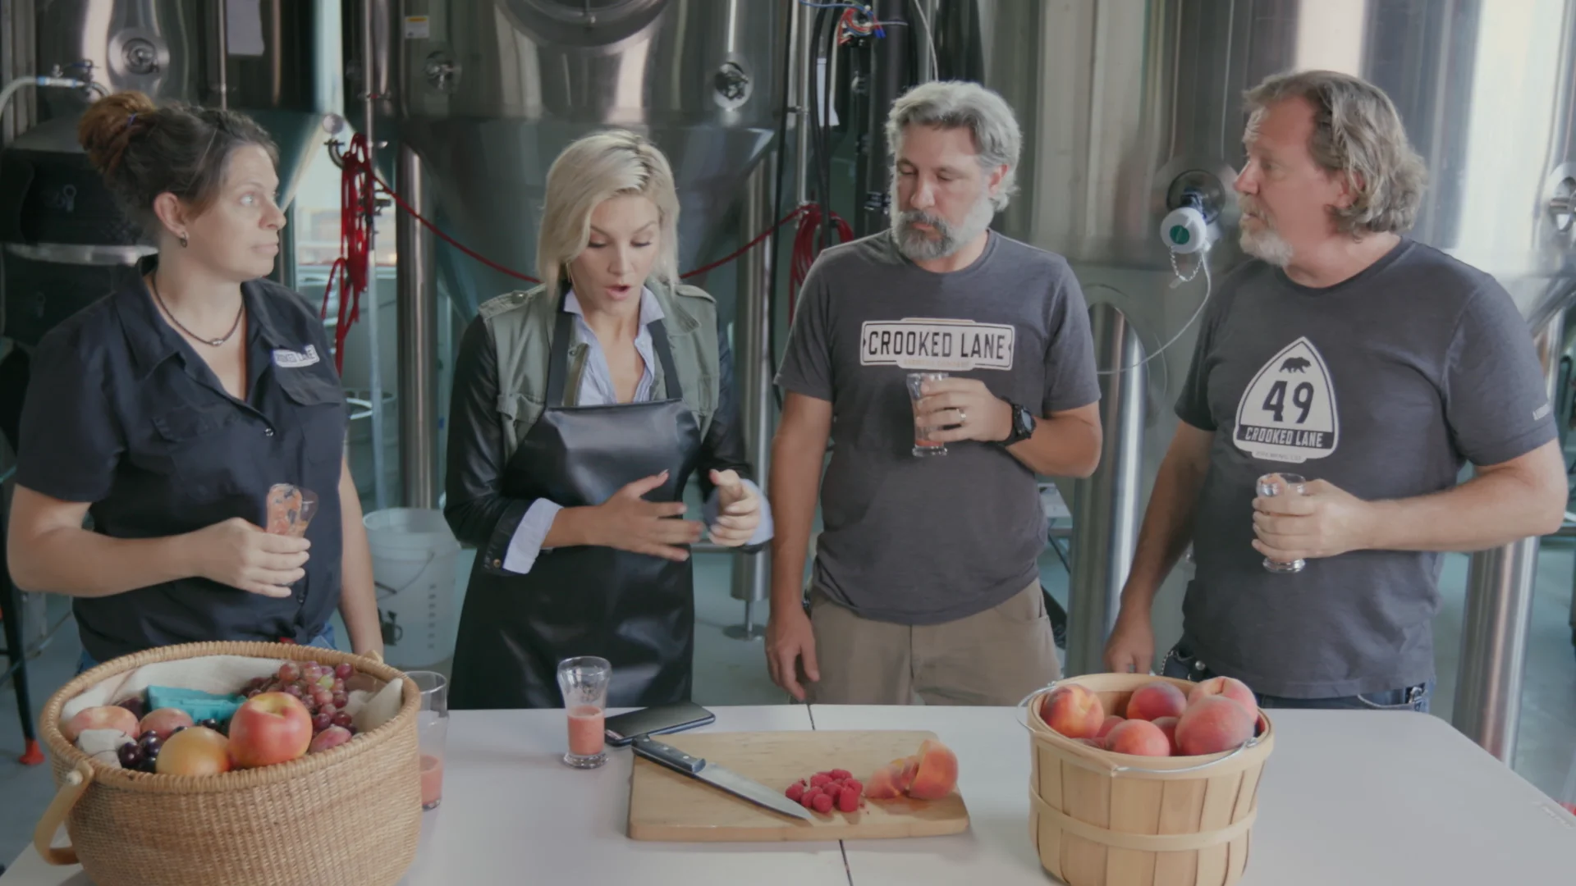
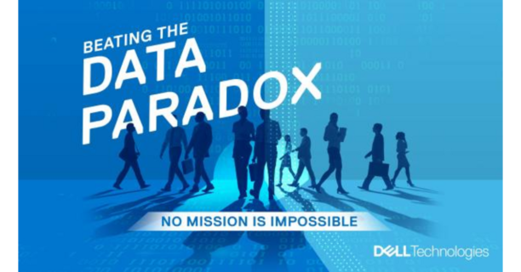
Competitor campaigns
HP- Meet the Intern YouTube Videos, using HP products to bring ideas to life
Dell- Influencer marketing campaign to promote eBook asset

Slide 10
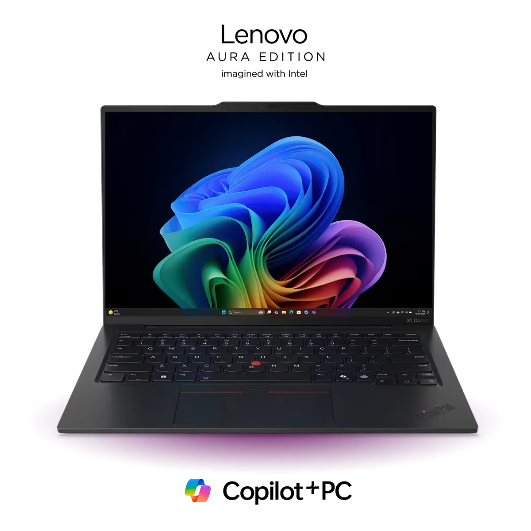
Promote the ThinkPad X1
  Designed for businesses
  AI PC with intelligent file search
Promote Lenovo Pro for businesses
Content Ideas

Slide 11

Channels & Content
Instagram
LinkedIn
YouTube
Short-Form Reels:
Emphasize the different features of the ThinkPad and how they can be used for complex tasks.
Short Posts w/ Video:
Speak from professional experience how Lenovo Pro can be beneficial for large-scale companies.
Long-Form Videos:
Expanded versions of the reels, featuring the more famous B2B influencers (ex: founders of large tech companies)

Slide 12
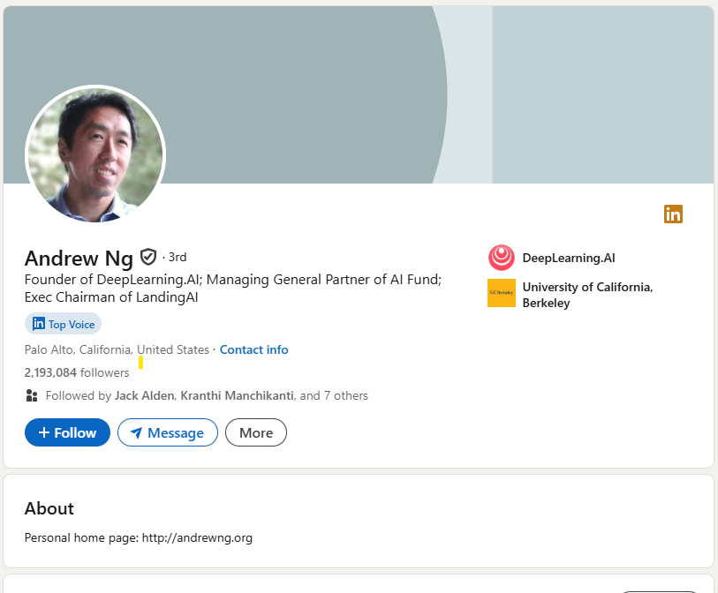
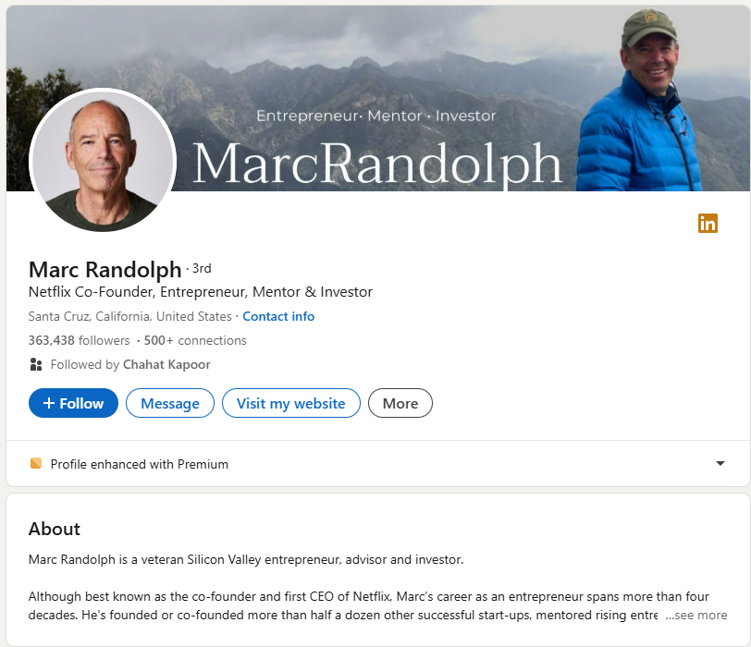
Possible Influencers
Coursera Co-Founder
Channels: LinkedIn/Youtube
Sector: Technology
Netflix Founder/Ex-CEO
Channels: LinkedIn/Youtube/Instagram
Sector: Technology, Finance

Slide 13
KPis
Post-Campaign Release
Impressions
Clicks
# of views on LinkedIn/Instagram posts based on company/industry
Clicks on the Lenovo Pro website/ThinkPad product page
Comments
Conversions
Executives from prospective companies interacting with LinkedIn/Instagram Posts
B2B consumers signing up for Lenovo Pro/buying products

Slide 14
Lenovo is struggling in the B2B sector compared to its competitors
  Mainly in the finance, tech, and consulting industries
To catch up with their competitors, Lenovo should use B2B influencer marketing
  Promote the top performing business laptop and Lenovo Pro deals
  Use social media channels to reach top executives
Using B2C strategies for B2b Marketing

Slide 15
Thanks
Do you have any questions?
Srika Sudheer
srika.sudheer@gmail.com

